Slide 1
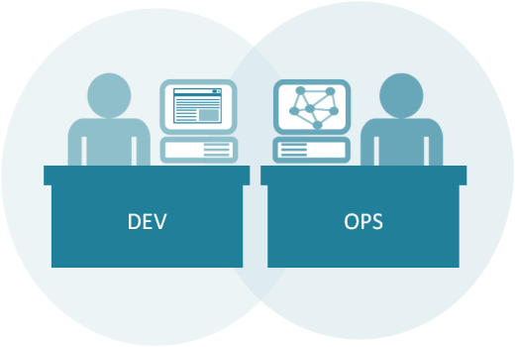
Introduction to Kubernetes
64300M_2.0_2018

Slide 2
Welcome!
Logistics (breaks, facilities, lunch, etc.)
Rules of Engagement
Introductions
Let’s Get Started!

Slide 3

Who is your instructor?
A little about me…

Slide 4
Introductions
What is your Name and Job Role?
Your company or team?
Expectations for the class?
Something interesting about yourself?

Slide 5
What to expect from this class
Flexibility
Conversations
Literacy and awareness on many of the principles, tools, and practices surrounding Microservices culture, architecture and implementation.
An effort to focus on your own situations and challenges so you can act on what you learn.

Slide 6
Introduction to Kubernetes
Part 1:

Slide 7

Journey is a “Team of Teams”
“First I needed to shift my focus from moving pieces on the board to shaping the ecosystem.”
– General S. McChrystal, Team of Teams: New Rules of Engagement for a Complex World

Slide 8
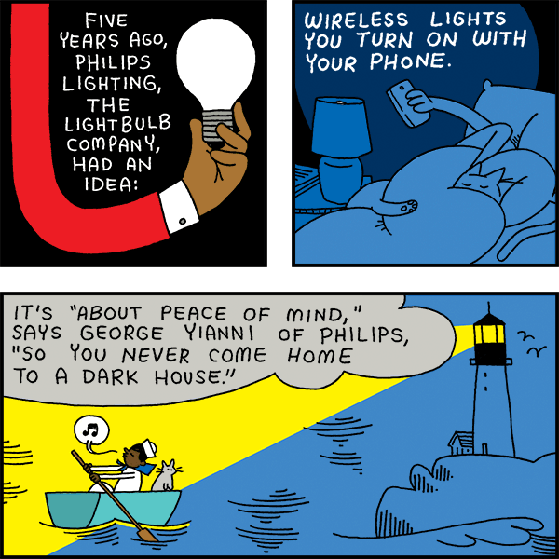
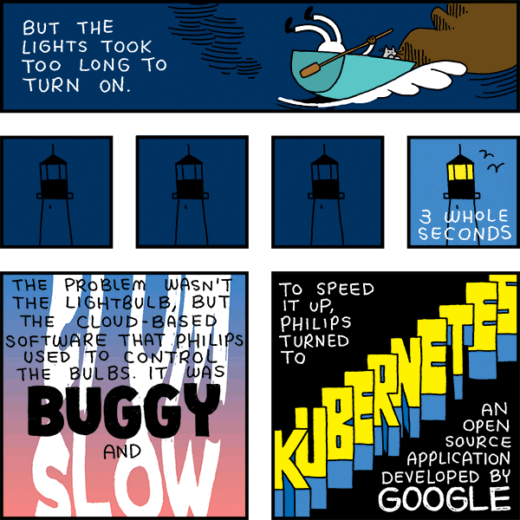
Kubernetes Intro (Phillips Case)
Notes:
https://www.bloomberg.com/features/2017-kubernetes/

Slide 9
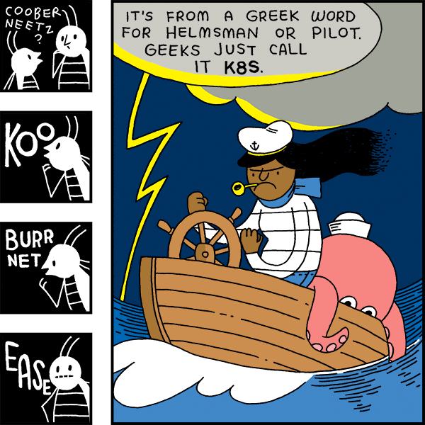
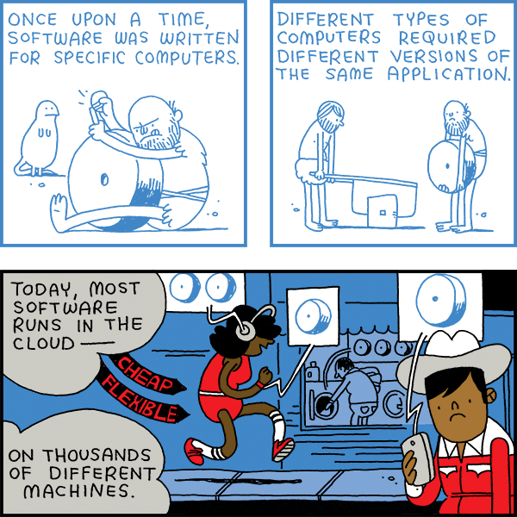
Kubernetes Intro (Phillips Case)
Notes:
https://www.bloomberg.com/features/2017-kubernetes/

Slide 10
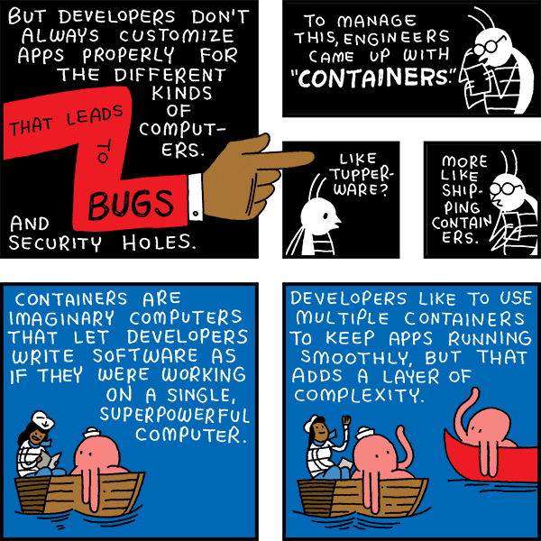
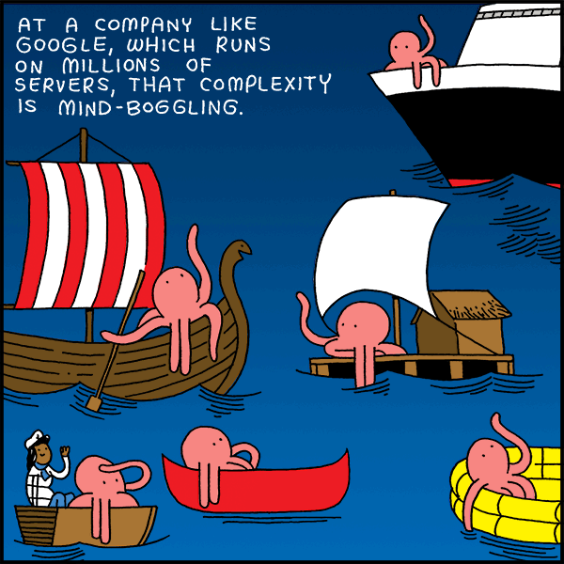
Kubernetes Intro (Phillips Case)
Notes:
https://www.bloomberg.com/features/2017-kubernetes/

Slide 11
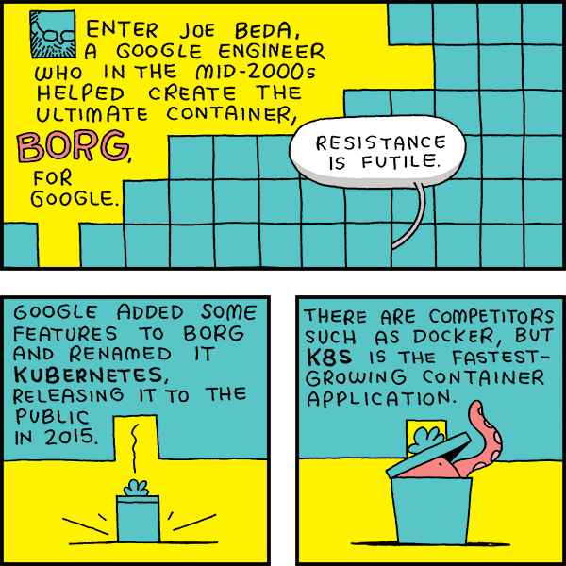
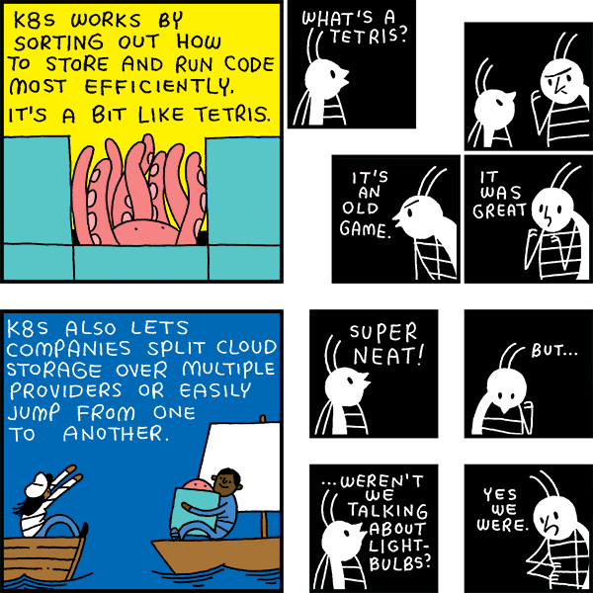
Kubernetes Intro (Phillips Case)

Slide 12
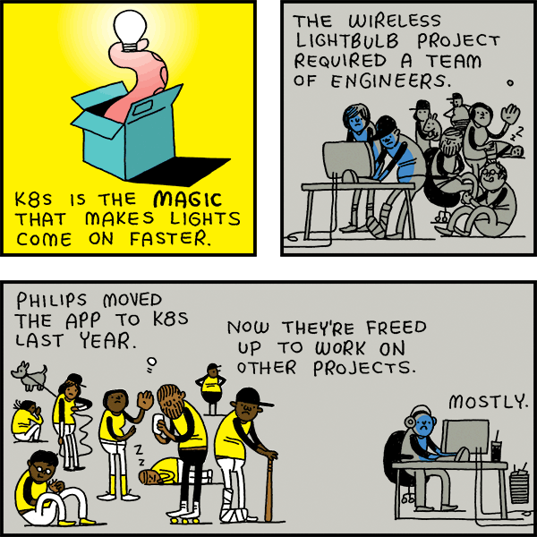
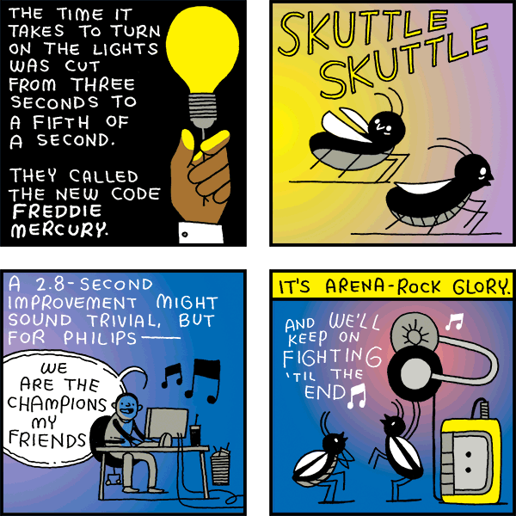
Kubernetes Intro (Phillips Case)
Notes:
https://www.bloomberg.com/features/2017-kubernetes/

Slide 13
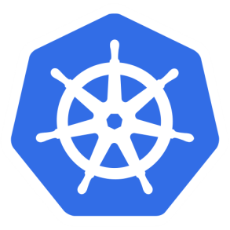
Kubernetes
The name Kubernetes is Greek
Translates to “helmsman” or “pilot”
Root of ”Governor” and “Cybernetic”
“K8s” is a shorthand abbreviation derived by replacing the 8 letters “ubernete” with 8.
Notes:
Trivia:
The founders initially wanted to call it “seven of nine” in reference to the nice, friendlier borg from Star Trek. This name did not survive, but for this reason the Kubernetes logo has seven sides
Reference:
https://cloudplatform.googleblog.com/2016/07/from-Google-to-the-world-the-Kubernetes-origin-story.html

Slide 14
Kubernetes
Project was originally started by Google, and shortly after joined by Redhat
Based on 10+ years of experience of using containers
The most famous of which named “Borg”, Google’s cluster manager “Borg”
Declarative
State desire (i.e. 5 pods)
System confirms to State (if currently 3 pods, system changes to 5. If unexpectedly goes to 4 pods, system restores to 5)
Notes:
https://static.googleusercontent.com/media/research.google.com/en//pubs/archive/44843.pdf

Slide 15

Cloud Native Computing Foundation (CNCF)
Mission of the Cloud Native Computing Foundation.
“The Foundation’s mission is to create and drive the adoption of a new computing paradigm that is optimized for modern distributed systems environments capable of scaling to tens of thousands of self healing multi-tenant nodes.”
Formed in Nov 6, 2015 with Kubernetes as its first project
The CNCF is building an ecosystem of complimentary projects including Prometheus, Fluentd, Linkerd, Rkt, and others
Notes:
https://www.cncf.io/about/charter/
1. Mission of the Cloud Native Computing Foundation. The Foundation’s mission is to create and drive the adoption of a new computing paradigm that is optimized for modern distributed systems environments capable of scaling to tens of thousands of self healing multi-tenant nodes.
Cloud native systems will have the following properties:
(a) Container packaged. Running applications and processes in software containers as an isolated unit of application deployment, and as a mechanism to achieve high levels of resource isolation. Improves overall developer experience, fosters code and component reuse and simplify operations for cloud native applications.
(b) Dynamically managed. Actively scheduled and actively managed by a central orchestrating process. Radically improve machine efficiency and resource utilization while reducing the cost associated with maintenance and operations.
(c) Micro-services oriented. Loosely coupled with dependencies explicitly described (e.g. through service endpoints). Significantly increase the overall agility and maintainability of applications. The foundation will shape the evolution of the technology to advance the state of the art for application management, and to make the technology ubiquitous and easily available through reliable interfaces.

Slide 16
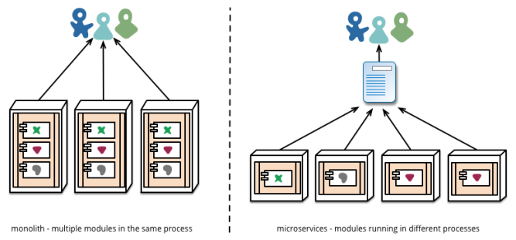
What is a Microservice?
A service that can be independently deployed
Notes:
https://martinfowler.com/articles/microservices.html

Slide 17
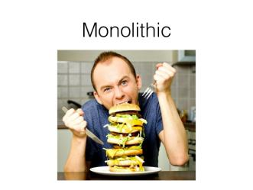
How big is a Microservice?
A single programmer can design, implement, deploy and maintain a microservice – Fred George
Software that fits in your head – Dan North

Slide 18
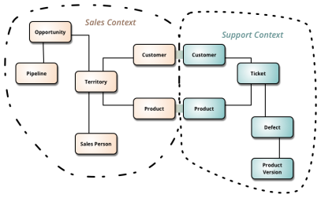
Where is the data for a Microservice?
A single logical database per service – Chris Richardson
A microservice implements a single Bounded Context – Martin Fowler, Sam Newman
Notes:
https://martinfowler.com/bliki/BoundedContext.html

Slide 19
How to maintain Microservices?
Addressable through a service discovery system – Chris Richardson
Microservices built & deployed independently. Stateless, with state as backing service s – 12Factor.net

Slide 20
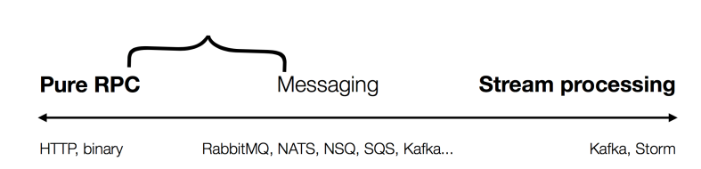
How to architect Microservices?
Typically
CRUD – Create, Read, Update and Delete api implementations
Range between RPC, Message and Stream processing
Evolve from a Monolith 1st iteration

Slide 21
Microservice: advantages
Simple services that are focused on doing one thing well
Each service can be built using the best tool for the job
Systems built this way are inherently loosely coupled
Teams can deliver and deploy independently from each other
Enable continuous delivery but allowing frequent releases while the rest of the system continues to be stable
Notes:
Can be (but not always)
< 6000 lines
https://martinfowler.com/articles/microservices.html

Slide 22
Microservices
Solve organizational problems
Teams blocked by or waiting on other teams
Communication overhead
Slow velocity
Cause Technical Problems
Requires Devops, devs deploying and operating their services
Need well defined business domains
More distributed systems
Need an orchestration layer

Slide 23
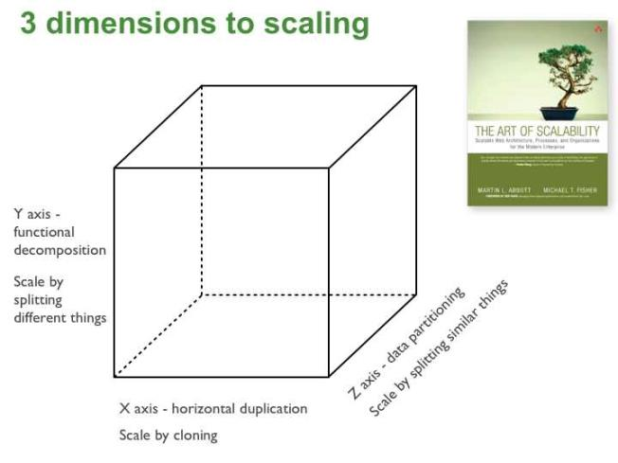
The Art of Scaling
Notes:
http://microservices.io/articles/scalecube.html
X-axis: Run multiple copies behind a load balancer
Pros
Simple
Cons
Doesn’t decrease complexity
Often limited by state not being effectively shared between instances
Y-axis: Splits the application into multiple different services
Pros
Decreases complexity
Most resource efficient
Cons
Requires intentional effort
Z-axis: Split application into different segments of data
Pros
Most memory resource efficient
Enables scalability
Cons
Most complex
Difficult to refactor

Slide 24
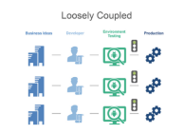
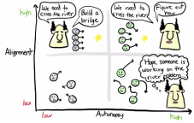
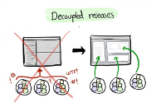
Small Team Size
Build platform with small teams of 6-8 engineer teams
Self Sufficient: Each team completely owns one or more services and has everybody they need to develop functionality
Automate Interfaces: Teams connect to each other through API’s. Teams don’t hire an army of program managers to manage dependencies.
Decentralized: Teams plan, develop and deploy autonomously
Starting and Scaling DevOps in the Enterprise by Gary Gruver https://www.amazon.com/dp/B01M332BN2/ref=dp-kindle-redirect?_encoding=UTF8&btkr=1
Notes:
https://clusterhq.com/2016/03/22/microservices-spotify-petter-mahlen
“There’s a yearly survey about what sucks about Spotify’s infrastructure. In 2015 service DB, the predecessor showed up as, I think, number 3 in what sucks. Whereas now, in 2016, System-Z is one of the things that gets the most frequent, “It’s great!” Even though we’re asking what sucks. “
“Another interesting thing we noticed is that it leads to teams building related features, infrastructure teams building related features, like an example is the team that owns hardware and provisioning, the team that owns DNS infrastructure, and the team that owns System-Z together have built like an improved version of how you do provisioning and deployment. “

Slide 25
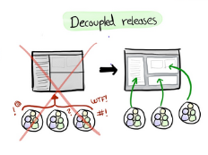
Why Small Team Size? Scaling the Organization
Autonomy
Decentralizes power and creates autonomy which is critical to scaling the organization
Each team can focus on the business metric they are responsible for and act autonomously to maximize the metric.
Amazon CTO Werner Vogels explained the advantages of this structure to Larry Dignan of Baseline in 2005. Dignan writes:
“Small teams are fast…and don’t get bogged down in so-called administrivia….Each group assigned to a particular business is completely responsible for it….The team scopes the fix, designs it, builds it, implements it and monitors its ongoing use. This way, technology programmers and architects get direct feedback from the business people who use their code or applications—in regular meetings and informal conversations.”
Science behind why two-pizza team works http://blog.idonethis.com/two-pizza-team/ ITRevolution, Conways Law by Gene Kim http://itrevolution.com/conways-law/
Notes:
http://blog.idonethis.com/two-pizza-team/
http://itrevolution.com/conways-law/

Slide 26
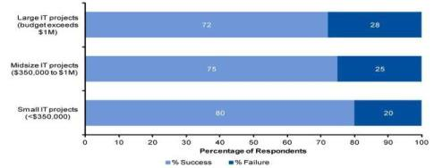
Why do Microservices?
Reduce complexity, increase success
According to a Gartner survey of 150 participants in 2011, the failure of projects exceeding $1 million was found to be almost 50% higher than for projects with budgets below $350,000.
This result was reinforced by prior Gartner IT projects which found small IT projects to experience a one-third lower failure rate than large projects
https://thisiswhatgoodlookslike.com/2012/06/10/gartner-survey-shows-why-projects-fail/

Slide 27
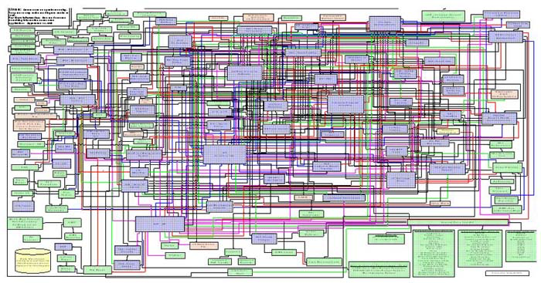
The Hairball(monolith)

Slide 28
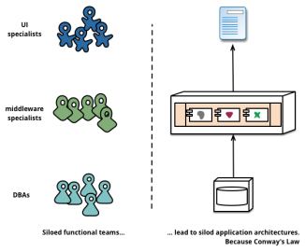
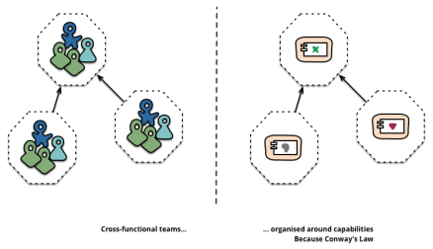
Because Conway’s Law
“Organizations which design systems … are constrained to produce designs which are copies of the communication structures of these organizations.” –Melvin Conway
Do This
Not that
Notes:
https://martinfowler.com/articles/microservices.html

Slide 29
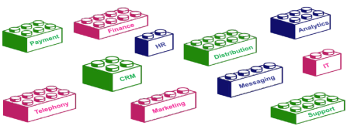
Microservice building blocks
APIs provide the flexibility for businesses to grow by adopting new business models and enable accelerated development of new applications.
It is like picking different LEGO blocks to build a toy house.
Notes:
Team Skills | Process & Measurements | Architecture & Engineering
3 bullets under each
(Insert Benchmark Here)

Slide 30
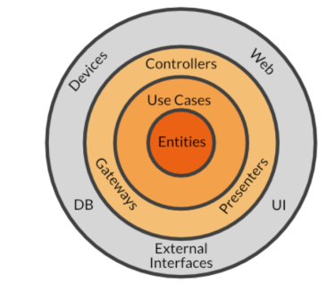
Clean Architecture
The central rule of The Clean Architecture is the Dependency Rule, which says:
Source code dependencies can only point inwards
(Dependency Injection)
Notes:
Dependency Injection
https://appliedgo.net/di/

Slide 31
Observability Metrics
USE method (Brendan Gregg)
For every resource, check
Utilization: average time that the resource was busy servicing work
Example: One disk is running at 90%
Saturation: the degree to which the resource has extra work which it can’t service, often queued
Example: The CPUs have an average run queue length of four
Error count (rate): the count of error events
Example: This network interface has had fifty late collisions
Useful for resources such as queues, CPU’s, memory, interconnects, etc
Notes:
http://www.brendangregg.com/usemethod.html

Slide 32
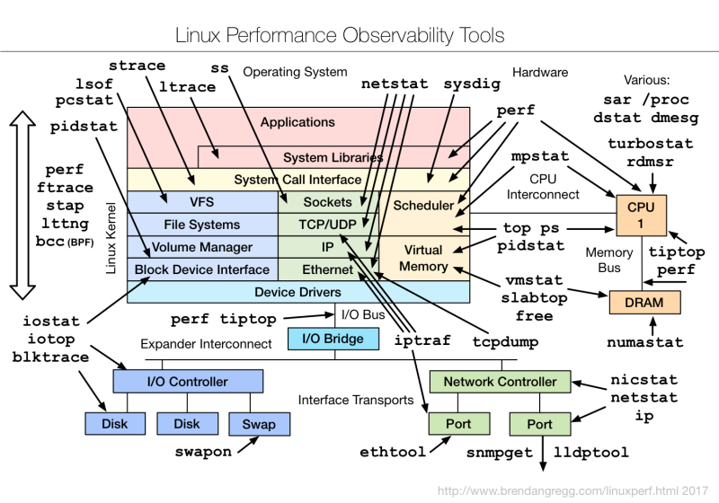
Notes:
http://www.brendangregg.com/linuxperf.html

Slide 33
Observability Metrics
RED method (Tom Wilkie)
For every service, check that
Request count (rate)
Error count (rate)
Duration
Are within SLO/A (service level objectives)
Useful for API endpoints
Note:
Observability = Logging + Monitoring + Tracing + Visualization
All good instrumentation libraries monitoring and trending systems (Prometheus, Graphite, etc) have at least three main primitives
Counter: records events that happen such as incoming requests, bad requests, errors, etc
Gauge: records things that fluctuate over time such as the size of a threadpool
Histogram: records observations of scalar quantities of events such as request durations
Notes:
http://www.brendangregg.com/usemethod.html

Slide 34
Optimize for Time to Value
“Today, when organizations measure and optimize their activities, time to value is becoming a dominant metric”
–Adrian Cockcroft, Devops thought leader reknown for architecture work at Netflix and VP of AWS

Slide 35
Kubernetes Setup
Kubernetes can be setup on multiple clouds
Google(GCP) & Microsoft offer Kubernetes as a service, with reliable experiences
AWS has two great open source methods, ’Kops’ and Heptio’s Cloud Formation Script
Last year AWS added Kubernetes as a Service
Kubernetes can readily be setup locally, with ‘Minikube’ or ‘kubeadm’
Notes:
http://gist-reveal.it/bit.ly/ato-k8s#/presented-by-ryanj

Slide 36

Local Kubernetes
https://github.com/abhikbanerjee
CLASSROOM WORK
Minikube is a option for developing locally, but some features are not available and require a cloud provider.
https://github.com/kubernetes/minikube
Notes:
Get prerequisites and install from https://github.com/kubernetes/minikube

Slide 37
Exercise 2.1 Kubernetes Master Installation
CLASSROOM WORK 20 minutes (required)
** This is an important exercise, if this exercise is not completed, you won’t be able to run any kubernetes related exercise
Install docker and docker-compose
Install kubectl
Install kubeadm
Install pod networking; Flannel
Initialize kubelet to create master node
https://github.com/techtown-training/kubernetes-intro/blob/master/exercise/exercise2.1-install_kube_master.md

Slide 38

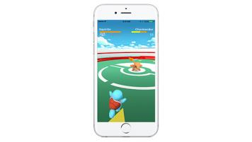
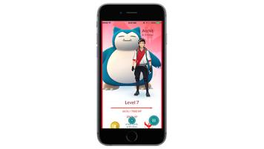
Pokemon Go

Slide 39
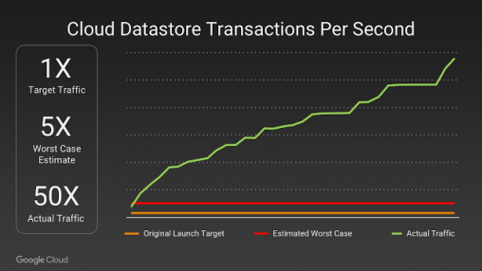
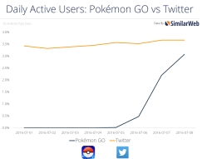
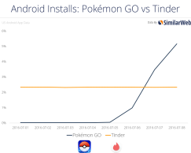
Pokemon Go: Situation
Pokemon Go launched a hit app! The application was a viral, overnight roaring success.
The challenge? It rapidly had 50x the worst case traffic estimate and grew rapidly
Achieved the same active users in a month that took Twitter years to reach
Was the most downloaded app in history within a few days
Notes:
Y Axis – Traffic to Cloud Datastore
X Axis - Date

Slide 40
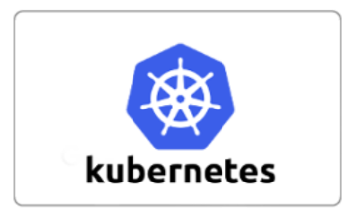

Pokemon Go: Action
Application for the logic ran on Google Container Engine powered by Kubernetes.
Enabled automation to scale the application to millions of users
Also enabled upgrading the version of the cluster and load balancer without downtime while millions of players were online

Slide 41

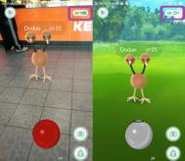
Pokemon Go: Action
Even Google doesn’t have unlimited resources and engineers
Google CRE (Cloud Reliability Engineer team) worked closely with Niantic to review and optimize the architecture.
Pokemon Go used Cloud Datastore, a cloud native NoSQL database.
This enabled the application to scale without the sharding requirements that would have been needed with MySQL or Postgres for example

Slide 42
Pokemon Go: Result
Was able to launch in Japan a mere two weeks after the US launch, where they received 3x the US users without incident.
Was the largest Kubernetes deployment ever, with multitude of bugs identified, fixed and merged into the open source repo
The cluster ended up utilizing tens of thousands of cores
Arguably the first successful overnight/viral planet-wide launch
Was eventually downloaded more than 500 million times and 25 million players at peak
Inspired users to walk over 5.4 billion miles over the course of a year due to gameplay
Notes:
https://news.ycombinator.com/item?id=12606995
https://cloudplatform.googleblog.com/2016/09/bringing-Pokemon-GO-to-life-on-Google-Cloud.html
http://www.theserverside.com/feature/How-Pokemon-Go-created-a-Kuburnetes-powered-Java-cloud
https://uploadvr.com/google-pokemon-go-server-issues-unavoidable/

Slide 43
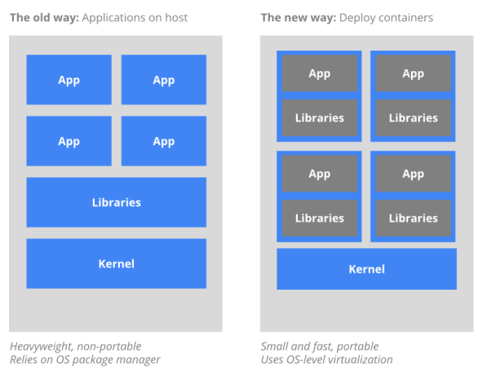
Containers
Notes:
Traditional Methods of deploying applications
Typically virtualize the hardware layer (i.e. virtual server)
Entangled executable, libraries, configuration and lifecycle with host OS
VMs tend to be heavier, approx 600MB to several GB
Hypervisor layer can take up to 33% of CPU overhead
Container based approaches
Operating system virtualization (i.e. virtual Linux machine)
Encapsulated executables, libraries, configuration, and lifecycle
Containers tend to be lighter, approx. 20MB to several hundred MB.
Container layer can typically take between 2-5% CPU overhead

Slide 44
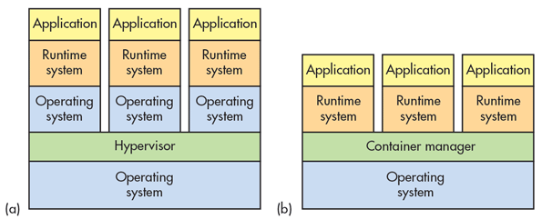
Container Advantages
Portable
Isolated
Lighter footprint & overhead (vs VMs)
Simplify Devops practices
Speed up Continuous Integration
Empower Microservice architectures and adoption

Slide 45
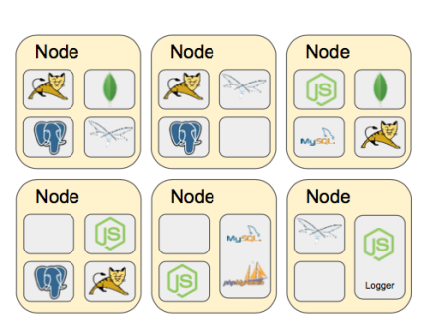
Challenges with multiple containers
How to scale?
Once I scale, where are they?
How do my containers find each other?
How should I manage port conflicts?
What if a host fails?
How to update them? Health checks?
How will I track their logs?

Slide 46
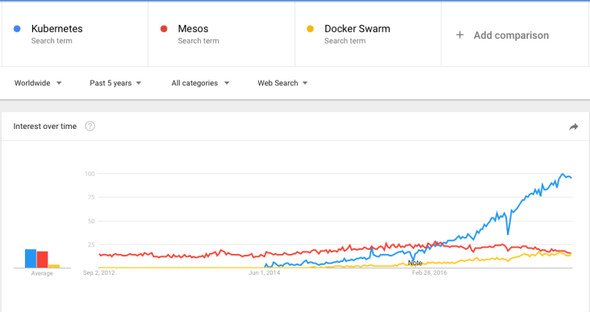
Container Orchestration Tools
The three most popular are: Kubernetes, Docker Swarm & Mesos
Kubernetes has become the unofficial standard
Notes:
Google started creation of its own open source orchestration tool ‘Kubernetes’. It has slowly gained dominance as the standard container orchestration tool except for niche use cases.
Mesos
Still used in early container adoption shops and big data applications
Docker Swarm
Lightweight and may be useful for rapid prototyping. With the ease of deploying Kubernetes to public cloud and greater feature set of Kubernetes this use case is increasingly shrinking.

Slide 47
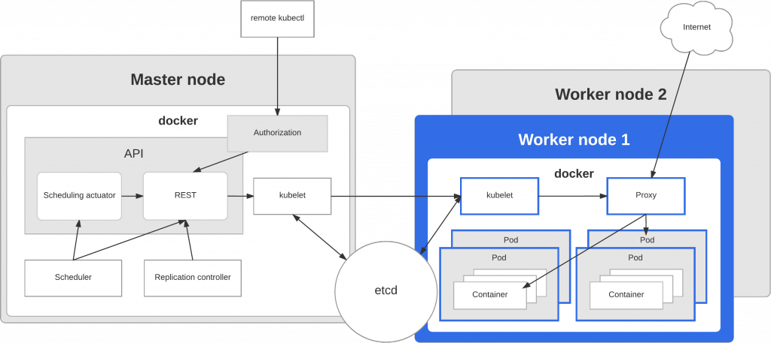
Kubernetes Architecture

Slide 48
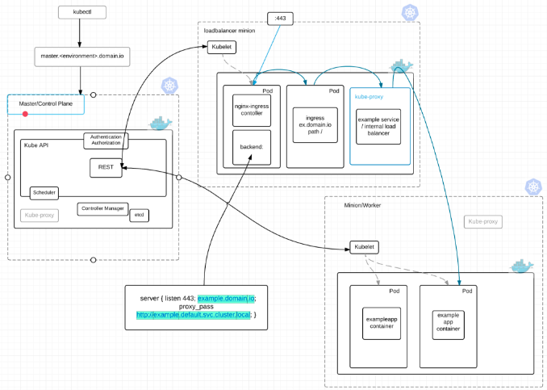
K8s Architecture – Networking view
Notes:
Image: http://www.devoperandi.com/load-balancing-in-kubernetes/

Slide 49
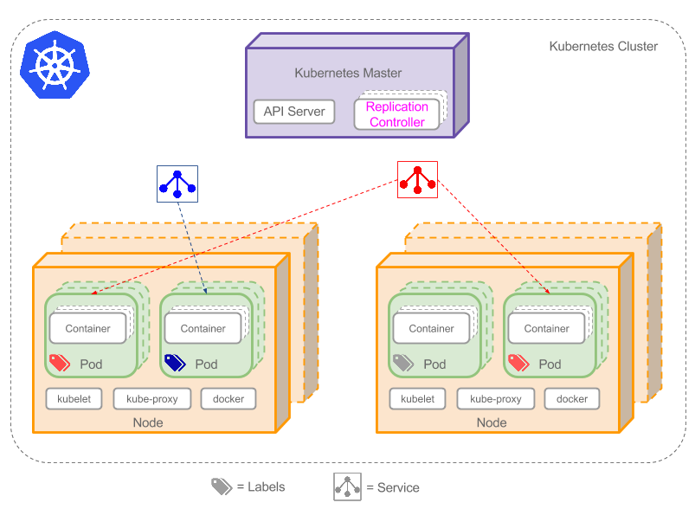
K8s Architecture – Simplified
Notes:
Image: http://www.devoperandi.com/load-balancing-in-kubernetes/

Slide 50
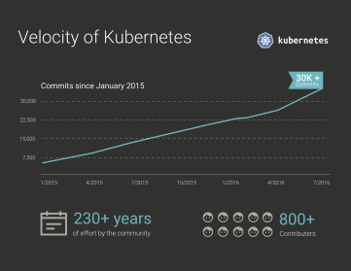
Kubernetes Stats
Top 100 project by stars
22k LinkedIn professionals
Largest container management ecosystem
Github
54k+ Commits | 280+ Releases | 1365+ Contributors
Top 100 Forked Github Project | Top 2 Starred Go Project | Top 0.01% Starred Github Project

Slide 51
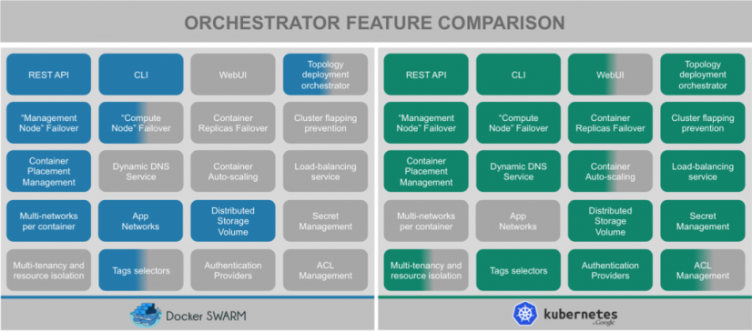
Feature Comparison (March 2016)
Notes:
This is a rapidly changing patch work. This snapshot is of 03/2016. (https://blog.octo.com/docker-en-production-la-bataille-sanglante-des-orchestrateurs-de-conteneurs/)
Since then Kubernetes has an improved WebUI, Autoscaling and Multi-tenancy features among others. It’s a fast moving space!

Slide 52



Github

Slide 53
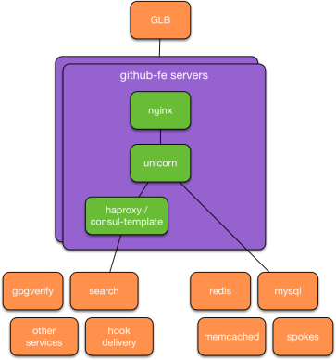
Github: Situation
Written in Ruby with Puppet managed servers, the Github legacy architecture had challenges
As traffic grew, latency started to increase
As more GitHubbers came on board, overhead increased
New services began to take days, weeks or months to deploy
Increasingly the SRE team began to spend a large percentage of their time on maintenance, not features
Notes:
https://githubengineering.com/kubernetes-at-github/
“Ruby on Rails application (we call it github/github) was configured a lot like it was eight years ago: Unicorn processes managed by a Ruby process manager called God running on Puppet-managed servers. Similarly, our chatops deployment worked a lot like it did when it was first introduced: Capistrano established SSH connections to each frontend server, then updated the code in place and restarted application processes. When peak request load exceeded available frontend CPU capacity, GitHub Site Reliability Engineers would provision additional capacity and add it to the pool of active frontend servers.”

Slide 54
Github: Situation
Over time, it because clear that this approach was not scaling. A joint team was formed to evaluate platforms against the following:
Self Service platform for engineers to enable capacity
Automate responding to changes in demand so changes can happen in seconds, not hours, days or more
Insulate applications from differences between development, staging, production, enterprise and other environments
Several properties helped Kubernetes stand out from other platforms
Vibrant open source community
First run experience meant a small application was up within hours
Wealth of information about the experience that motivated the design
Notes:
https://githubengineering.com/kubernetes-at-github/

Slide 55
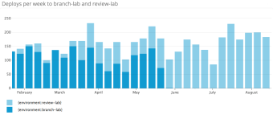
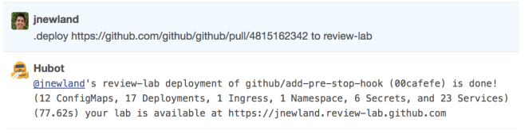
Github: Action
Before: Deploy environments were booked solid during business hours, challenging engineers ability to test their pull requests
After: Implemented capability for a chat-based interface for creating isolated deploys of Github for pull requests. This greatly enabled developer throughput as it empowered engineers to self service new environments with their Pull Requests.
Notes:
Sub projects shipped:
“
A Kubernetes cluster running in an AWS VPC managed using a combination of Terraform and kops.
A set of Bash integration tests that exercise ephemeral Kubernetes clusters, used heavily in the beginning of the project to gain confidence in Kubernetes.
A Dockerfile for github/github.
Enhancements to our internal CI platform to support building and publishing containers to a container registry.
YAML representations of 50+ Kubernetes resources, checked into github/github.
Enhancements to our internal deployment application to support deploying Kubernetes resources from a repository into a Kubernetes namespace, as well as the creation of Kubernetes secrets from our internal secret store.
A service that combines haproxy and consul-template to route traffic from Unicorn pods to the existing services that publish service information there.
A service that reads Kubernetes events and sends abnormal ones to our internal error tracking system.
A chatops-rpc-compatible service called kube-me that exposes a limited set of kubectl commands to users via chat.
“

Slide 56
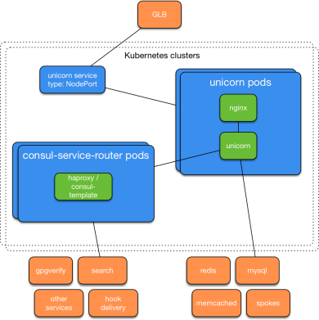
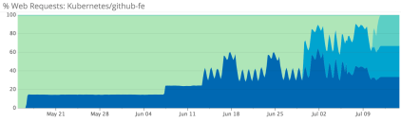
Github: Result
Building on their success with the previous Kubernetes deployment, Github began to migrate their front end to Kubernetes
Migrated from Legacy system to a K8s cluster in AWS to finally a K8s cluster in their data center on bare metal
Traffic was migrated to the Kubernetes system without incident
The original goals of self service, responsiveness and scalable environments was achieved
Engineers have rolled out dozens of projects in a self service manner, and Github’s SRE’s are focusing more on delivering infrastructure products.
Github plans to start investigating and moving stateful services to K8s in the future.
Notes:
https://githubengineering.com/kubernetes-at-github/
https://news.ycombinator.com/item?id=15029086
Subprojects in Github FE Deployment
“A timely and thorough post about container networking helped us select the Calico network provider, which provided the out-of-the box functionality we needed to ship a cluster quickly in ipip mode while giving us the flexibility to explore peering with our network infrastructure later.
Following no less than a dozen reads of @kelseyhightower’s indispensable Kubernetes the hard way, we assembled a handful of manually provisioned servers into a temporary Kubernetes cluster that passed the same set of integration tests we used to exercise our AWS clusters.
We built a small tool to generate the CA and configuration necessary for each cluster in a format that could be consumed by our internal Puppet and secret systems.
We Puppetized the configuration of two instance roles - Kubernetes nodes and Kubernetes apiservers - in a fashion that allows a user to provide the name of an already-configured cluster to join at provision time.
We built a small Go service to consume container logs, append metadata in key/value format to each line, and send them to the hosts’ local syslog endpoint.
We enhanced GLB, our internal load balancing service, to support Kubernetes NodePort Services.
“

Slide 57
Why Kubernetes?
Kubernetes is an open-source system for automating deployment, scaling, and management of containerized applications.
Co-locating helper processes, facilitating composite applications and preserving the one-application-per-container model
Mounting storage systems
Distributing secrets
Checking application health
Replicating application instances
Using Horizontal Pod Autoscaling
Naming and discovering
Balancing loads
Rolling updates
Monitoring resources
Accessing and ingesting logs
Debugging applications
Providing authentication and authorization
This provides the simplicity of Platform as a Service (PaaS) with the flexibility of Infrastructure as a Service (IaaS), and facilitates portability across infrastructure providers.
Notes:
What does Kubernetes mean? K8s? Pronounced ”Kates”
The name Kubernetes originates from Greek, meaning helmsman or pilot, and is the root of governor and cybernetic. K8s is an abbreviation derived by replacing the 8 letters “ubernete” with “8”

Slide 58
Master Components
kube-apiserver - Component on the master that exposes the Kubernetes API. It is the front-end for the Kubernetes control plane.
etcd - Consistent and highly-available key value store used as Kubernetes’ backing store for all cluster data
kube-scheduler - Component on the master that watches newly created pods that have no node assigned, and selects a node for them to run on.
kube-controller-manager
Node Controller: Responsible for noticing and responding when nodes go down.
Replication Controller: Responsible for maintaining the correct number of pods for every replication controller object in the system.
Endpoints Controller: Populates the Endpoints object (that is, joins Services & Pods).
Service Account & Token Controllers: Create default accounts and API access tokens for new namespaces.
cloud-controller-manager - runs controllers that interact with the underlying cloud providers.

Slide 59
Node Components
kubelet - An agent that runs on each node in the cluster. It makes sure that containers are running in a pod.
kube-proxy - kube-proxy enables the Kubernetes service abstraction by maintaining network rules on the host and performing connection forwarding.
Container Runtime - The container runtime is the software that is responsible for running containers. Kubernetes supports several runtimes: Docker, rkt, runc and any OCI runtime-spec implementation

Slide 60
Addons
DNS - While the other addons are not strictly required, all Kubernetes clusters should have cluster DNS, as many examples rely on it.
Web UI (Dashboard) - Dashboard is a general purpose, web-based UI for Kubernetes clusters.
Container Resource Monitoring - Container Resource Monitoring records generic time-series metrics about containers in a central database, and provides a UI for browsing that data.
Cluster-level Logging - A Cluster-level logging mechanism is responsible for saving container logs to a central log store with search/browsing interface.

Slide 61
Kubernetes Terms
Containers
Nodes
Clusters
Deployment
Pods
ReplicaSets
Services
Labels
Volumes

Slide 62
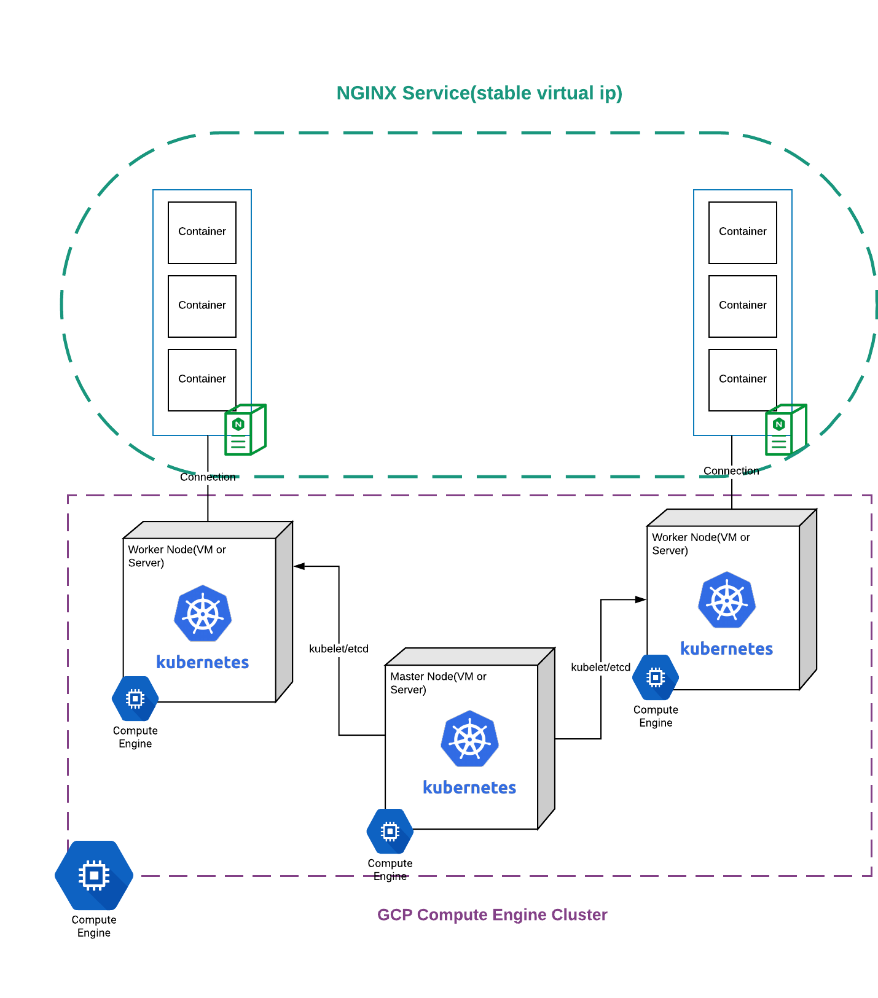
Kubernetes: Abstraction

Slide 63

Kubernetes: Nodes
A node is a worker machine in Kubernetes. A node may be a VM or physical machine, depending on the cluster. Each node has the services necessary to run pods and is managed by the master components. The services on a node include Docker, kubelet and kube-proxy. See The Kubernetes Node section in the architecture design doc for more details.

Slide 64

Kubernetes: Nodes
Allows Pods to be scheduled. A basic worker physical or virtual machine of Kubernetes.
Must be managed by a master
May host multiple pods
Internal IP Address endpoint
Can be tagged and filtered using labels
Must be running two processes
Kubelet – Kubernetes client process. Communicates with master and schedules pods
Container runtime – Docker, Rocket, etc. Pulls and runs containers from registry

Slide 65
Kubernetes: Nodes
Node Status
A node status contains:
Addresses
Hostname
ExternalIP
InternalIP
Condition - describe condition of nodes.
Capacity - describe the resources available on the node
Info - general information about the node

Slide 66
$ kubectl get nodes
Note: Afinity & Anti-affinity (Beta) allow further constraints on where a pod may run (coupled, de-coupled, only nodes with certain labels, etc)
Notes:
Kubectl get nodes
As long as you have a working cluster and connection to the cluster this command should work. This is usually one of the first commands you call to ensure the cluster is alive.
http://kubernetesbyexample.com/nodes/

Slide 67

Kubernetes: Clusters
Allows you to deploy containerized applications to a cluster without tying them specifically to individual machines.
Masters
Coordinates the cluster
Schedules applications
Maintains application state
Scales applications
Rolls out updates
Can be duplicated when HA (High Availability) is desired.
Often run as a service by public cloud providers (Azure/Google Kubernetes as a Service)
Nodes
House workers that run the applications
Three node minimum for production clusters

Slide 68

Kubernetes: Pods
Allows you to create a group of one or more containers and some shared resources for those containers
Pod Resource Types
Networking, as a unique cluster IP address
Container information:
container image version
specific ports
Etc
Atomic unit of Kubernetes
Tied to node which is it scheduled
Always co-located and co-scheduled
Containers in a pod share
IP address and port space
Filesystem
Storage (Volumnes)
Labels
Secrets
Notes:
Additionally, pods can be tagged with a label for recommended scheduling advice

Slide 69

Kubernetes: Deployments
Allows you to deploy a (self-healing) instance of an application.
Self Healing: Continuously monitors and replaces instances if necessary
Provides declarative updates for Pods and ReplicaSets
Updates actual state to desired state at a controlled rate
For example: Current state, 3 instances of Tomcat. Desired state, 5 instances of Tomcat. -> Create 2 more instances of Tomcat
Relay on declarative manifest to determine intent (i.e. yaml/json file most commonly)
Notes:
Deployments (and controllers) are loops that maintain state.

Slide 70

$ kubectl create
Note: This is just creation of the pod. In order to expose it, a service must be created. In order for it to be respawned, a deployment or replication control must be created.
Notes:
Create a pod.yaml with the following contents
apiVersion: v1
kind: Pod
metadata:
name: nginx
labels:
name: nginx
spec:
containers:
- name: nginx
image: nginx
ports:
- containerPort: 80
2. Kubectl create –f pod.yaml
3. Kubectl get pods
This highlights an example of Kubernetes deployment creation. As with many Kubernetes objects, deployments are usually created from a file such as a yaml or json. While this could be done via command line it is often impractical to do so.
Further reading:
https://kubernetes.io/docs/concepts/workloads/controllers/deployment/#creating-a-deployment
Note: This is a simple pod. This is interesting.

Slide 71


$ kubectl get pods
Note: Logs from pods are readily available with a kubectl logs <podname> command.
Notes:
This highlights an example of listing Kubernetes pods and also getting the logs from said pod.
Logging: more detail
https://kubernetes.io/docs/concepts/cluster-administration/logging/

Slide 72
Exercise 2.2 Kubernetes Connect
CLASSROOM WORK (15 minutes)
Kubernetes Simple Example
Start a deployment (pod will start automatically)
Expose deployment as service
https://github.com/techtown-training/kubernetes-intro/blob/master/exercise/exercise2.2-k8s_simple_example.md
** Note – later we will discuss about pods, deployment, service in details. This exercise is just to start running containers, but a lot will be clear in later slides
Notes:
Create a cluster (or reuse a cluster from earlier exercises) and connect to it
Execute the nginx example
https://github.com/kubernetes/kubernetes/blob/master/examples/simple-nginx.md
Some repetition here is intentional. You should be comfortable creating clusters, establishing a connection, verifying its healthy, and then cleaning up resources. This foundation is essential before moving on to advanced concepts

Slide 73
Kubernetes: ReplicaSets
A ReplicaSet ensures that a specified number of pod replicas are running at any other time. If there are too many pods, the ReplicationController terminates the extra pods. If there are too few, the ReplicationController starts more pods. Unlike manually created pods, the pods maintained by a ReplicationController are automatically replaced if they fail, are deleted, or are terminated.
For example, your pods are re-created on a node after disruptive maintenance such as a kernel upgrade. For this reason, you should use a ReplicationController even if your application requires only a single pod. A ReplicationController is similar to a process supervisor, but instead of supervising individual processes on a single node, the ReplicationController supervises multiple pods across multiple nodes.

Slide 74
Kubernetes: Service
Kubernetes Pods are mortal. They are born and when they die, they are not resurrected. ReplicaSets in particular create and destroy Pods dynamically (e.g. when scaling up or down). While each Pod gets its own IP address, even those IP addresses cannot be relied upon to be stable over time. This leads to a problem: if some set of Pods (let’s call them backends) provides functionality to other Pods (let’s call them frontends) inside the Kubernetes cluster, how do those frontends find out and keep track of which backends are in that set?
A Kubernetes Service is an abstraction which defines a logical set of Pods and a policy by which to access them - sometimes called a micro-service. The set of Pods targeted by a Service is (usually) determined by a Label Selector (see below for why you might want a Service without a selector).

Slide 75

Kubernetes: Service
Abstraction regarding a set of pods which enables load balancing, traffic exposure, load balancing and service discovery.
Abstraction that allows pods to die and replicate in Kubernetes without affecting your application.
Enable loose coupling between different Pods.
Provides a stable virtual IP and port
Services allow Pods to receive traffic.
Each Pod has a unique IP but those IP addresses are not exposed outside the Pod without a service.

Slide 76

$ kubectl get services
Note: A component called ‘kube-proxy’ runs on each node and implements a form of virtual IP for services of type other than ‘ExternalName’
Notes:
kubectl get services --all-namespaces
This reveals the kubernetes services that are usually running as part of the kubernetes system namespace.
http://kubernetesbyexample.com/services/

Slide 77
Kubernetes Connect
CLASSROOM WORK
Kubernetes 101 (Part 2 – Run only below section)
Deployments and Replica sets
Services
Back to Deployments
https://github.com/techtown-training/kubernetes-intro/blob/master/exercise/exercise2.3-k8s_simple_example.md
Notes:
https://github.com/gravitational/workshop/blob/master/k8s101.md
Git clone https://github.com/gravitational/workshop.git
Sections:
Deployments and Replicasets
Services
Back to Deployments

Slide 78

Kubernetes: Label
Key/Value pairs that can be attached to objects to enable a variety of use cases.
Designate objects for specific environments such as development, test and production
Set versions to objects
Set roles or other arbitrary information to classify objects
Can be added or modified at any time

Slide 79
Kubernetes Command Line Tool: kubectl
Most common access point for launching workloads on Kubernetes clusters.
kubectl [command] [TYPE] [NAME] [flags]
Very popular commands
kubectl get - list resources about a target.
kubectl get services
kubectl get pods
kubectl describe - show basic information about a resource
Kubectl describe pods my-pod
kubectl logs - print the logs from a container in a pod. Extremely useful
Kubectl logs my-pod
Also useful:
kubectl exec - execute a command on a container in a pod
Kubectl top – Show metrics for a node
Notes:
Trivia: Some internal Kubernetes engineers pronounce kubectl as ‘kubecuttle’

Slide 80

$ kubectl get pod –l name=<label>
Note: Best mechanism to organize Kubernetes objects
Notes:
kubectl run nginx --image nginx --port 80
kubectl get pods
kubectl label pods nginx-158599303-04h8d new-label=awesome
kubectl get pods -l new-label=else
kubectl get pods -l new-label=awesome
kubectl get pods --show-labels
http://kubernetesbyexample.com/labels/

Slide 81


Kubernetes: Scaling
Changing the number of resources to meet a desired state
Accomplished by adjusting the number of replicas in a deployment
Accommodates both scaling up and scaling down to a minimum of 0
Traffic is automatically sent to newly created instances through the service load balancer
Can be used to enable rolling updates without downtime

Slide 82

$ kubectl scale deployments/<deployment> --replicas=<new num>
Note: Make sure to delete the deployments or replicasets when trying to clear out pods. Many a new user has repeated deleted pods and gotten frustrated when they respawn (as the deployments/replicasets are programed to do).
Notes:
kubectl run nginx –image nginx –port 80
kubectl get deployments
kubectl scale deployments/nginx –replicas=2
kubectl get deployments
http://kubernetesbyexample.com/labels/

Slide 83




Kubernetes: Rolling Update
Updates the pods in a serial manner will load balancing traffic to available instances
If deployment is exposed publicly, the service will load-balance traffic to only active and available pods
Used to enable zero downtime updates
Allows greater application update frequency
Can also be leveraged to rollback to previous versions

Slide 84

$ kubectl set image <deployment> <new-image>
Note: Rolling updates can also be undone (see next slide)
Notes:
Stand up nginx but with an older version, 1.12.1
1. kubectl run nginx --image nginx:1.12.1 --port 80
Set image to the newer version (latest). This triggers kubernetes to begin a rolling update
2. kubectl set image deployments/nginx nginx=nginx:latest
Observe the newer image has been rolled out
3. kubectl describe deployment nginx

Slide 85

$ kubectl rollout undo <deployment>
Note: Rollbacks can also be also enacted with zero-downtime
Notes:
Roll back to previous version nginx 1.12.1
4. kubectl rollout undo deployments/nginx
Observe changes
5. kubectl describe deployments/nginx

Slide 86
Exercise – 2.5 (RC, RS, Deploy) 20 minutes
Exercise to create Replication Controllers, Replica Sets and Deployments and describe their functions
Check the results and describe the objects
sudo su –
You already have the cloned the github project [https://github.com/techtown-training/microservices-bootcamp.git]
Navigate to ‘exercise/src_code/kubernetes_additional_exercise/ex2.5/’ – for all config files required for this exercise
Exercise instruction:-
https://github.com/techtown-training/kubernetes-intro/blob/master/exercise/exercise2.5-rs_rc_deploy.md
Ref:- https://www.mirantis.com/blog/kubernetes-replication-controller-replica-set-and-deployments-understanding-replication-options/

Slide 87
Exercise – 2.6 (Pods, Deploy, Services) 15 minutes
For all the concepts discussed until now
Create pods, Services, Deployments
Various ways to use the create command
We already have the git repo cloned in our machines.
Navigate to ‘exercise/src_code/kubernetes_additional_exercise/ex2.6/’ – for all config files required for this exercise
Exercise instruction:-
https://github.com/techtown-training/kubernetes-intro/blob/master/exercise/exercise2.6-pod_deploy_service.md
Ref:- https://www.linkedin.com/learning/learning-kubernetes/next-steps
Notes:
kubectl get services --all-namespaces
This reveals the kubernetes services that are usually running as part of the kubernetes system namespace.
http://kubernetesbyexample.com/services/
As mentioned previously, a Service is backed by a group of Pods. These Pods are exposed through endpoints. The Service’s selector will be evaluated continuously and the results will be POSTed to an Endpoints object also named my-nginx. When a Pod dies, it is automatically removed from the endpoints, and new Pods matching the Service’s selector will automatically get added to the endpoints. Check the endpoints, and note that the IPs are the same as the Pods created in the first step:

Slide 88
Exercise – 2.7 (Kubernetes Labels ) 15 minutes
Create a series of pods with different labels
Query the pods based on various labels
Delete pods based on certain selectors
We already have the git repo cloned in our machines.
Navigate to ‘exercise/src_code/kubernetes_additional_exercise/ex2.7/’ – for all config files required for this exercise
Exercise instruction:-
https://github.com/techtown-training/kubernetes-intro/blob/master/exercise/exercise2.7-label_usage.md
Ref:- https://www.linkedin.com/learning/learning-kubernetes/next-steps
Notes:
Create a cluster (or reuse a cluster from earlier exercises) and connect to it
Execute the nginx example
https://github.com/kubernetes/kubernetes/blob/master/examples/simple-nginx.md
Some repetition here is intentional. You should be comfortable creating clusters, establishing a connection, verifying its healthy, and then cleaning up resources. This foundation is essential before moving on to advanced concepts

Slide 89


Kubernetes at Box

Slide 90


Box: Situation
“In the summer of 2014, Box was feeling the pain of a decade’s worth of hardware and software infrastructure that wasn’t keeping up with the company’s needs”
50 Million users, including several large enterprises such as General Electric
Originally a PHP monolith of millions of lines of code
Primarily hosted on bare metal within their own data centers
Early adopter of Puppet representing one of its largest implementations
Customer pressure to host workloads and data on every major cloud
Was taking more than six months to deploy a new microservice

Slide 91

Box: Action
Box was an early adopter in Kubernetes. Working with the open source and contributing to the very early versions.
Was initially attracted to the design documentation and influence from Google’s experience with Borg, a bare metal container orchestration platform
Also enjoyed the shared API primitives such as pods, services, and deployments that other PaaS layers such as OpenShift and Deis were building on top of.
"There was clearly a pent-up demand for a better way of building software through microservices, and the increase in agility helped our developers be more productive and make better architectural choices."
Notes:
Full quote:
While observing teams who began to use Kubernetes for their microservices, "we immediately saw an uptick in the number of microservices being released," Ghods notes. "There was clearly a pent-up demand for a better way of building software through microservices, and the increase in agility helped our developers be more productive and make better architectural choices."

Slide 92

Box: Result
Kubernetes at Box represented a shift towards cloud native development techniques
"Kubernetes, and cloud native in general, represents a pretty big paradigm shift, and it’s not very incremental”
"We’re essentially making this pitch that Kubernetes is going to solve everything because it does things the right way and everything is just suddenly better”
Microservices have decreased to taking less than five days to deploy (from six months), and have the goal to getting that number under an hour
Notes:
"Ghods predicts that Kubernetes has the opportunity to be the new cloud platform. '...because it’s a never-before-seen level of automation and intelligence surrounding infrastructure that is portable and agnostic to every way you can run your infrastructure.'"
https://kubernetes.io/case-studies/box/
https://news.ycombinator.com/item?id=12145423
https://cnkc16.sched.com/event/8K8u/how-box-runs-containers-in-production-with-kubernetes-sam-ghods-box
https://architecht.io/box-co-founder-on-moving-to-microservices-and-the-promise-of-kubernetes-a49f01b1c0c0

Slide 93



Kubernetes cheat sheet
Notes:
Kubectl cheat sheet (collection of useful commands):
https://kubernetes.io/docs/user-guide/kubectl-cheatsheet/

Slide 94
Kubernetes: Volumes
On-disk files in a container are the simplest place for an application to write
data, but this approach has drawbacks. The files are lost when the container crashes or stops for any other reason. Furthermore, files within a container are inaccessible to other containers running in the same Pod. The Kubernetes Volume abstraction addresses both of these issues.
A directory accessible to all containers in a pod
Volumes out live containers that run within a pod
May be passed between pods
Data is preserved across container restarts

Slide 95

Kubernetes: Volumes
Note: Volumes are based on a wide assortment of underlying storage provides. Every major public cloud (including Azure) has several options for volume storage
Notes:
1. kubectl create -f https://raw.githubusercontent.com/mhausenblas/kbe/master/specs/volumes/pod.yaml
Shell into the first pod
2. kubectl exec sharevol -c c1 -i -t -- bash
Write data to an ‘xchange’ file
3. mount | grep xchange
4. echo 'some data' > /tmp/xchange/data
Exit out of container
5. exit
Now shell into the 2nd container
6. kubectl exec sharevol -c c2 -i -t – bash
7. mount | grep /tmp/data
8. cat /tmp/data/data
View the whole pod.yaml file here: https://github.com/openshift-evangelists/kbe/blob/master/specs/volumes/pod.yaml
Kubernetes by example Volumes: http://kubernetesbyexample.com/volumes/

Slide 96
Kubernetes: Persistent Volumes
Persistent storage in a cluster
Managing storage is a distinct problem from managing compute. The PersistentVolume subsystem provides an API for users and administrators that abstracts details of how storage is provided from how it is consumed.
A PersistentVolume (PV) is a piece of storage in the cluster that has been provisioned by an administrator. It is a resource in the cluster just like a node is a cluster resource. PVs are volume plugins like Volumes, but have a lifecycle independent of any individual pod that uses the PV. This API object captures the details of the implementation of the storage, be that NFS, iSCSI, or a cloud-provider-specific storage system.

Slide 97

Kubernetes: Persistent Volumes
Persistent storage in a cluster
Separate to PersistentVolumeClaim, which is a request for storage.
May be created ahead of time in a static manner for use by a cluster
May be created dynamically from available, unclaimed resources
May be freed and passed from user to user so care should be taken to delete contents when done with use
Critical for Stateful containers

Slide 98
Exercise 3.1 Wordpress on Kubernetes
CLASSROOM WORK 30 minutes
Create persistent volume
Create secret for MySQL password
Launch Wordpress
Source code:
https://github.com/techtown-training/kubernetes-intro/blob/master/exercise/src_code/kubernetes_additional_exercise/ex3.1
Step by step instruction
https://github.com/techtown-training/kubernetes-intro/blob/master/exercise/exercise3.1-create_pv.md
https://github.com/techtown-training/kubernetes-intro/blob/master/exercise/exercise3.1-create_volumes.md
Notes:
https://kubernetes.io/docs/tutorials/stateful-application/mysql-wordpress-persistent-volume/
Change to “apps/v1beta1” for kind=deployment in both yaml file

Slide 99
Introduction to Kubernetes
Part 2:

Slide 100


Kubernetes: Logging
Aggregate, access and print logs from containers
Logs can be accessed from a currently run container or any number or previously run containers, accessed by container name
Containerized apps write logs to stdout and stderr
Cluster level logging can be performed using several different techniques including node level agents, container sidecars, or even having containers push directly to an application
Node level logging is the most common approach, typically using Elasticsearch.
Notes:
Print Logs
Kubectl logs logme
Stream logs
Kubectl logs –f logme

Slide 101


Kubernetes: Logging
Note: An external system can perform the log rotation by calling logrotate, which would result in kubectl logs returning an empty result
Notes:
Create a loging pod
1. kubectl create -f https://raw.githubusercontent.com/mhausenblas/kbe/master/specs/logging/pod.yaml
Grab the last few lines of logs
2. kubectl logs --tail=5 logme -c gen
Grab a stream of the logs
3. kubectl logs -f --since=10s logme -c gen
Clean up
4. kubectl delete -f https://raw.githubusercontent.com/mhausenblas/kbe/master/specs/logging/pod.yaml
Now launch a container that performs an action and then exits. Give it a minute or so to close out
5. kubectl create -f https://raw.githubusercontent.com/mhausenblas/kbe/master/specs/logging/oneshotpod.yaml
Now output the logs of this container
6. kubectl logs -p oneshot -c gen
Clean up
7. kubectl delete -f https://raw.githubusercontent.com/mhausenblas/kbe/master/specs/logging/oneshotpod.yaml
http://kubernetesbyexample.com/logging/

Slide 102
Kubernetes: Stateful Sets
Stateful Sets manage the deployment and scaling of a set of Pods, and provides guarantees about the ordering and uniqueness of these Pods.
Like a Deployment, a Stateful Set manages Pods that are based on an identical container spec. Unlike a Deployment, a StatefulSet maintains a sticky identity for each of their Pods. These pods are created from the same spec, but are not interchangeable: each has a persistent identifier that it maintains across any rescheduling.
A StatefulSet operates under the same pattern as any other Controller. You define your desired state in a StatefulSet object, and the StatefulSet controller makes any necessary updates to get there from the current state.
Notes:
https://kubernetes.io/docs/concepts/workloads/controllers/statefulset/

Slide 103
Kubernetes: Stateful Sets
StatefulSets are valuable for applications that require one or more of the following:
Stable, unique network identifiers.
Stable, persistent storage.
Ordered, graceful deployment and scaling.
Ordered, graceful deletion and termination.
Ordered, automated rolling updates.
Notes:
https://kubernetes.io/docs/concepts/workloads/controllers/statefulset/

Slide 104

Kubernetes: Stateful Sets
Functionality of deployments with guarantees about ordering and unique identities per Pod.
Pods in a stateful set are not interchangeable
Each Pod has a persistent identifier
Define desired state object, controller performs updates to desired state
Useful for applications that require persistent storage, unique network identifiers, ordered deployment, deletes or updates.
Notes:
https://kubernetes.io/docs/concepts/workloads/controllers/statefulset/

Slide 105

Kubernetes: Namespace
Partitions the names of API objects
Resources are segmented within namespaces
Sandbox per developer for example
Pods will route dns to default (own) namespace
api.default.svc.cluster.local
Api.foo…
The same app could run independently in different namespaces

Slide 106

Kubernetes: Namespace
Note: Namespaces create an excellent mechanism to subdivide resources and provide isolation. This enables using a cluster for multiple projects or multiple teams
Notes:
Get default namespaces
1. kubectl get ns
Create a ‘test’ namespace
2. kubectl create -f https://raw.githubusercontent.com/mhausenblas/kbe/master/specs/ns/ns.yaml
Recheck namespaces and observe
3. kubectl get ns
Now create a pod in this new namespace
4. kubectl create --namespace=test -f https://raw.githubusercontent.com/mhausenblas/kbe/master/specs/ns/pod.yaml
Check pods in this new namespace
5. kubectl get pods --namespace=test

Slide 107

Kubernetes: Secrets
An object that contains a small amount of sensitive data such as a password, token or key.
According to 12-factor configuration comes from the environment
Config is everything that is likely to vary between deployments
Can be used by pods and the underlying Kubelet when pulling images
Secrets belong to a specific Kubernetes Namespace
Secret size cannot exceed 1MB
Notes:
Additional Info:
https://developer.ibm.com/recipes/tutorials/use-kubernetes-secrets-to-make-your-app-portable-across-clouds/

Slide 108

Kubernetes: Secrets
Note: Can be mounted as data volumes or exposed as environment variables
Notes:
http://kubernetesbyexample.com/secrets/
1. echo -n "A19fh68B001j" > ./apikey.txt
2. kubectl create secret generic apikey --from-file=./apikey.txt
3. kubectl describe secrets/apikey
4. kubectl create -f https://raw.githubusercontent.com/mhausenblas/kbe/master/specs/secrets/pod.yaml
5. kubectl exec consumesec -c shell -i -t – bash
6. mount | grep apikey
7. cat /tmp/apikey/apikey.txt

Slide 109
Exercise 3.2 Kubernetes Secrets
CLASSROOM WORK - Optional
Create Secret config file and pods
Install and Launch Vault
https://github.com/techtown-training/kubernetes-intro/blob/master/exercise/exercise3.2-secrets.md
Notes:
Tutorial: https://github.com/kelseyhightower/oscon-2017-kubernetes-tutorial/blob/master/labs/04-tutorial-secrets.md
Optional Challenge: https://github.com/kelseyhightower/oscon-2017-kubernetes-tutorial/blob/master/labs/05-challege-secrets.md

Slide 110


Kubernetes: Configmap
A set of key-value pairs that serve as configuration data for pods. They solve the problem of how to pass config data such as environment variables to pods.
Config maps are commonly composed of:
Command line arguments
Environment variables
Files in a volume
Config maps function similar to secrets, but values are stored as strings and are more readily readable.
Notes:
http://pwittrock.github.io/docs/user-guide/configmap/
Extra resources:
https://docs.openshift.org/latest/dev_guide/configmaps.html

Slide 111
Exercise 3.3 Kubernetes Configmap
CLASSROOM WORK
Create Configmap
Consume Configmap in environment variables
Set command line using Configmap
Source code:
https://github.com/techtown-training/kubernetes-intro/tree/master/exercise/src_code/kubernetes_additional_exercise/ex3.3
Step by step instruction:
https://github.com/techtown-training/kubernetes-intro/blob/master/exercise/exercise3.3-configmap.md
Notes:
http://pwittrock.github.io/docs/user-guide/configmap/
Note: It may be easier to wget the files for the exercise.
wget http://pwittrock.github.io/docs/user-guide/configmap/configmap.yaml
kubectl create -f configmap.yaml
Instead of:
kubectl create -f docs/user-guide/configmap/configmap.yaml

Slide 112
Kubernetes Tools : Prometheus
Prometheus is an open source time series monitoring and alerting toolkit (originally written by SoundCloud). It is sponsored by the Cloud Native Computing Foundation and was the second project to be adopted after Kubernetes.
Dimensional Data
Powerful Queries
Visualization Tools
Efficient Storage
Alerting System

Slide 113

Kubernetes & Prometheus (Metrics)
CLASSROOM WORK
Stand up Prometheus
Gather and monitor metrics
Notes:
Promotheus is an open source time series monitoring and alerting toolkit (originally written by SoundCloud). It is sponsored by the Cloud Native Computing Foundation and was the second project to be adopted after Kubernetes.
https://prometheus.io/docs/introduction/overview/
Stand up simple Prometheus cluster
1. https://github.com/kelseyhightower/oscon-2017-kubernetes-tutorial/blob/master/labs/06-tutorial-metrics.md
Note: Accessing the prometheus cluster locally with minikube: localhost:9090
Additional info:
https://www.weave.works/blog/monitoring-kubernetes-infrastructure/
https://coreos.com/blog/prometheus-and-kubernetes-up-and-running.html
https://koudingspawn.de/kubernetes-monitoring-prometheus/

Slide 114
Extending Kubernetes
Helm - package manager
Third party extensions/plugins
Operators

Slide 115

Secure Service to Service Communication
How to authenticate the user and then pass the login context between Microservices (pods)?
How will each Microservice authorize the user?
Notes:
https://medium.facilelogin.com/securing-microservices-with-oauth-2-0-jwt-and-xacml-d03770a9a838

Slide 116

Secure Service to Service Communication: OpenID & JSON Web Token (JWT)
OpenID is a flavor of OAuth2
OAuth2 returns an access token called an ID Token or JSON Web Token
Pros
Distributes identity and entitlements between services
Transfers securely over an unsecured channel
Asserts identity as long as sender is trusted
Cons
Must provision the trusted certificates by service to each Microservice
Must trust every certificate
Notes:
https://kubernetes.io/docs/admin/authentication/#openid-connect-tokens

Slide 117

Secure Service to Service Communication: Private Certificate Authority
Pros
Enables Services to only trust either root certificate authority or intermediary
Reduced overhead in certificate provisioning
Cons
Newer technique and technologies, must be appropriate for the given project
Notes:
‘SPIFFE’ and ’Istio’ projects are developing a solution for this issue
https://github.com/istio/auth
https://github.com/spiffe/spiffe

Slide 118

Secure Traffic
Secure traffic between Microservices
HTTPS
Re-configure ELBs (on AWS)
Add certificate (letsencrypt.org)
Secure traffic for users
HTTPS
Secure Identity with SPIFFEE & Istio
Notes:
SPIFFE is an early effort to provide automation around certificates, identity and inter microservice communication
https://github.com/spiffe/spire
Istio is a platform desired to connect, manage, and secure microservices
https://istio.io/

Slide 119
Security Actions
Ensure attacker who gains access to web container can’t get into the database
Create separate DB users for each microservice
Strong passwords
K8’s secrets and/or Vault
Only accessed by containers who need them

Slide 120
Kubernetes Secrets
CLASSROOM WORK
Create Secret config file and pods
Install and Launch Vault
(Optional) Challenge: Replicate Vault Secrets into Kubernetes
Notes:
Tutorial
https://github.com/kelseyhightower/oscon-2017-kubernetes-tutorial/blob/master/labs/04-tutorial-secrets.md
Optional Challenge:
https://github.com/kelseyhightower/oscon-2017-kubernetes-tutorial/blob/master/labs/05-challege-secrets.md

Slide 121

Security - Microsegmentation
Segment the network
Only allow white-listed traffic between pods
Common tools
Istio
Calico
Weave
OpenContrail

Slide 122

Security – Least Privilege
“Each subject in a system be granted the most restrictive set of privileges”
Disable public IP access for any machine that doesn’t need it
VPN only for admin access

Slide 123
Security Actions
Limit admin access
ABAC mode by default
Commonly in srv/kubernetes
Access control by token
Can allow/deny API operations
Can be used to only allow certain actions
Webhook (optional)
Add url for k8s to verify authorization

Slide 124
Secure Images
Follow best practices for packaging and distributing applications
In general, try not to mix secrets and images
This can include containers with passwords baked in

Slide 125

Kubernetes Networking
Kubernetes assumes that pods can communicate with other pods, regardless of host
Kubernetes requires
All containers to communicate with other containers without NAT
All nodes can communicate with all containers without NAT
IP that container sees itself as is the same as others see it
In practice, Kubernetes cannot be installed simply with Docker. It usually requires a networking layer such as Weave, Flannel, etc
Notes:
Additional Info:
https://jvns.ca/blog/2016/12/22/container-networking/

Slide 126
Kubernetes Networking
Every pod has its own IP
No mapping ports
Clean, backwards compatible model where Pods can be treated like VMs

Slide 127

Kubernetes Ingress
Simplified Layer 7 access to Kubernetes services i.e. allows “internet” to reach services
Works with load balancers, including nginx & cloud
Single root URL mapping
Publicly expose private networks
Terminates TLS/SSL

